Slide 1

Presentation for the Front-end Part
3 mins per group

Slide 2

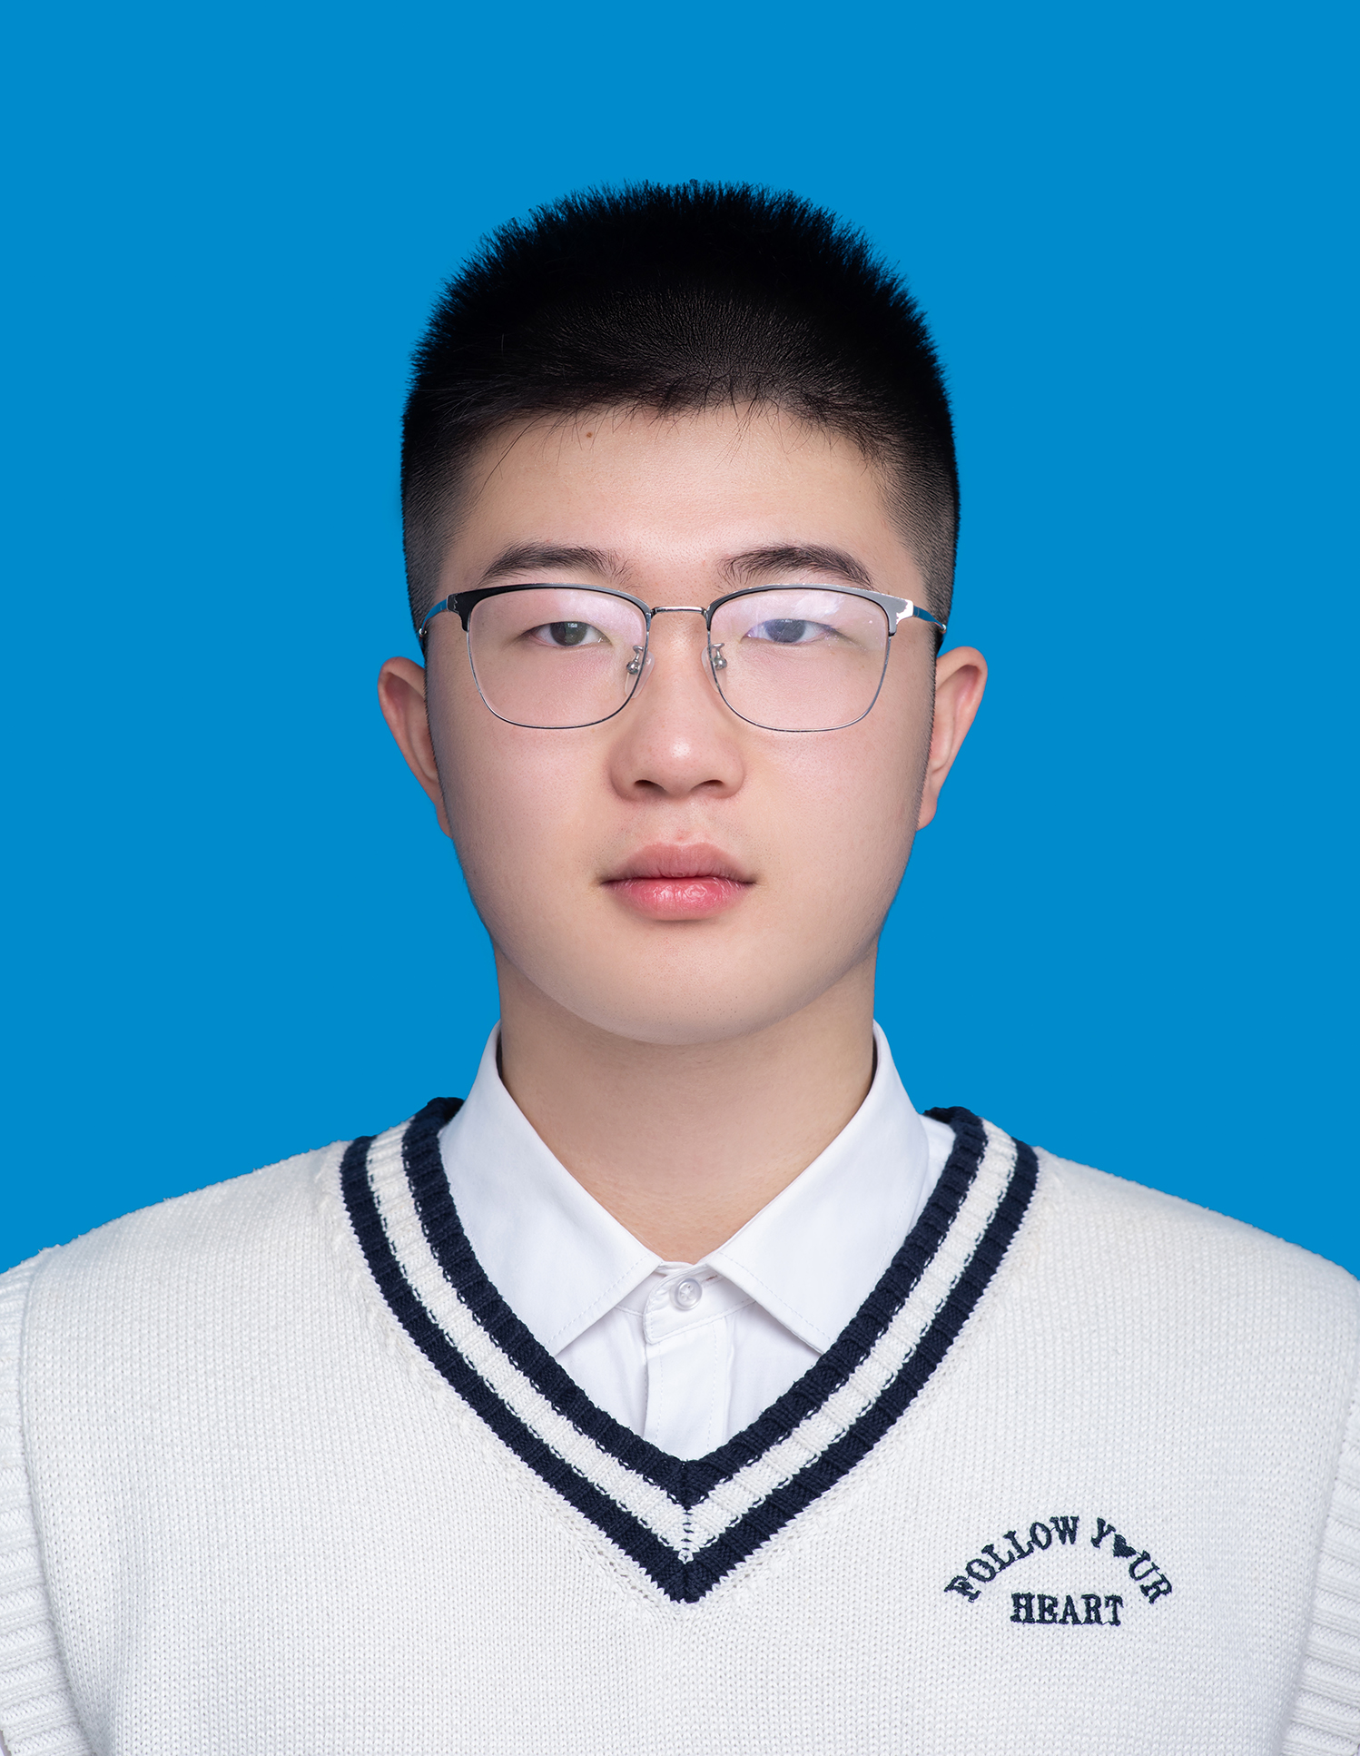

1. Member
** project leader
(who will upload this presentation to the Moodle )
1. Name ID Sec. 20232088
2. Name ID Sec. 20232084
zhairuitong
Weijinge(Submerge)
** project leader

Slide 3
2. Project name/Project Goal
Project name: The Social Anti-Fake News System
Project goal:
to help check fake news. The users who heard the news can enter the news into the system,
so the other users can see all the news. The other users can look at the news and vote
whether this news is fake or not, and put their comments on why they think this is fake or

Slide 4
3. Features
The home page displays a news list and provides categorized filtering (all/fake news/Non-fake news/Unknown)
Supports pagination function and allows for customizing the number of displays per page (5/10/15/20 items)
The news detail page fully displays the content, reporter information and related pictures
The community voting mechanism enables users to judge the authenticity of news and post comments
The comment system supports paginated browsing and uploading of image evidence
Data is stored using LocalStorage and does not rely on server requests
The voting results dynamically calculate the news status and update the classification in real time
The system is deployed on the Vercel platform and contains a complete simulation dataset.

Slide 5
4. Tech Stack
React 19, React Router 7
Vite (rolldown-vite@7.1.14)
Tailwind CSS 4 + PostCSS
ESLint (React Hooks/Refresh)

Slide 6
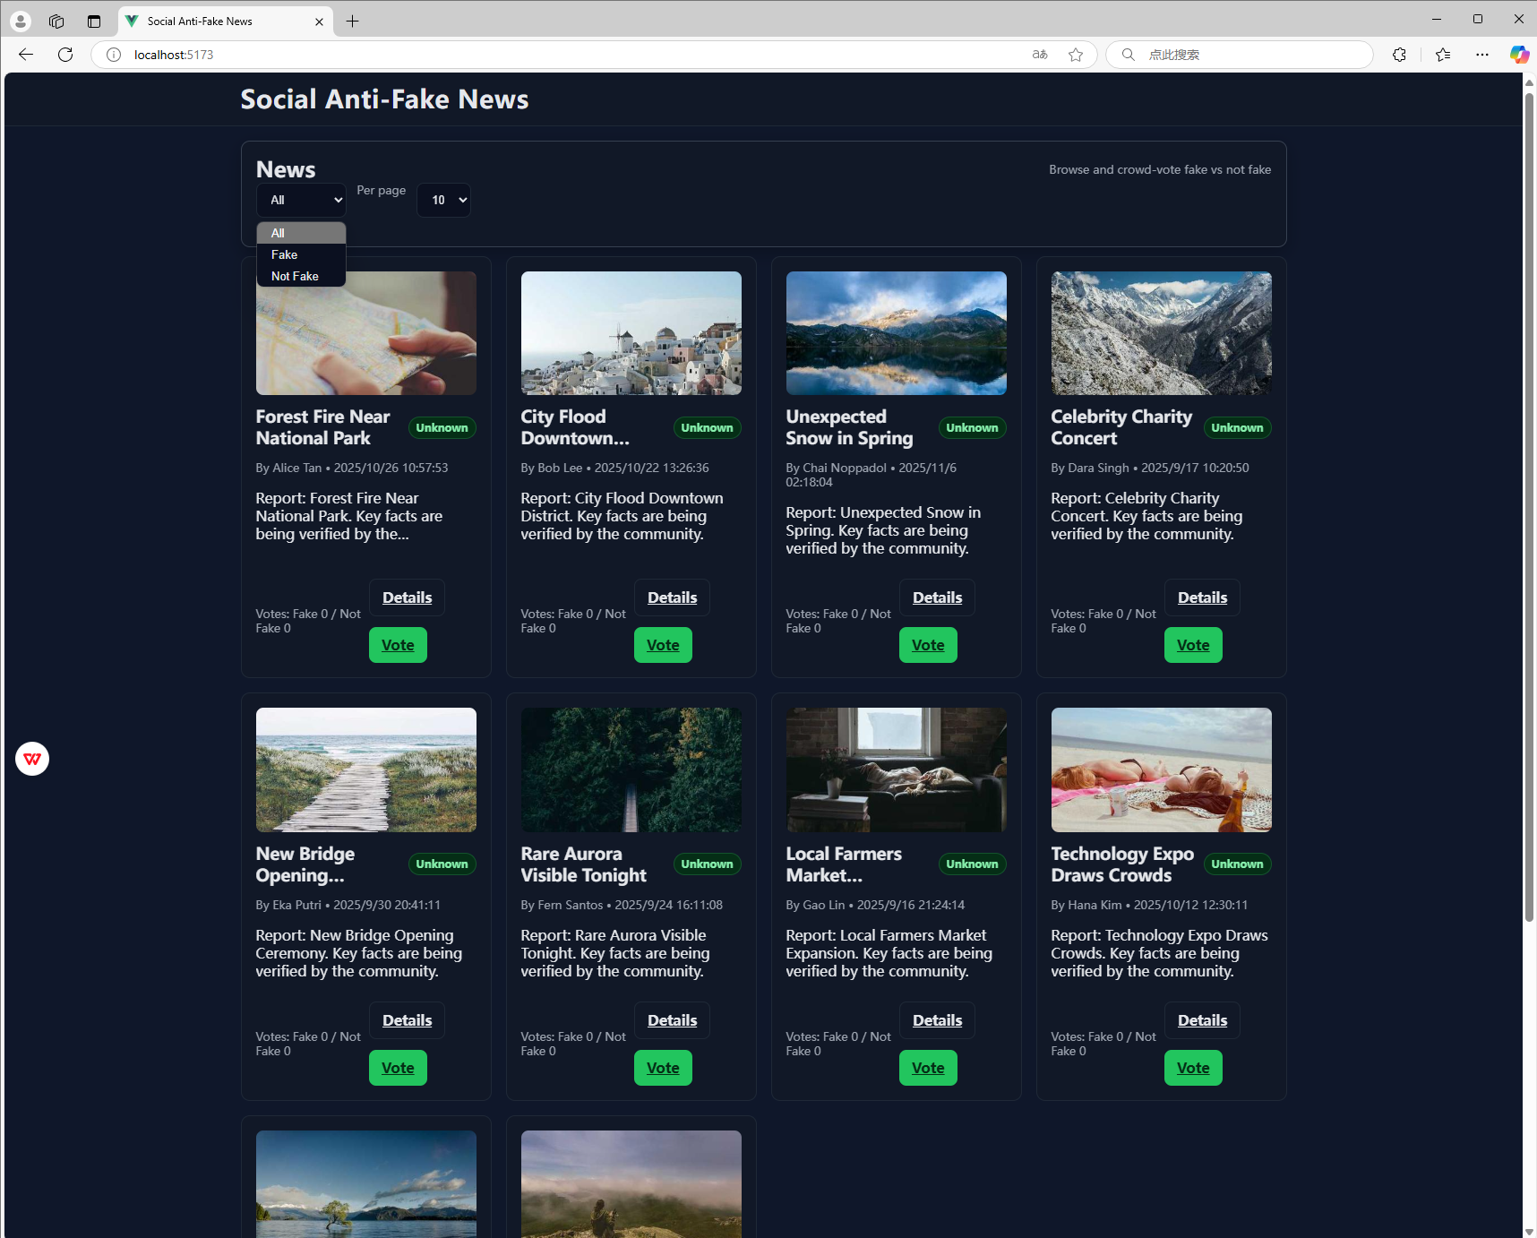
5. Home page
Home lists news with three filters:
1 Domain,
2 Filter (All/Fake/Not Fake/Uncertain),
3 Per page. Pagination keeps browsing fast and focused.

Slide 7
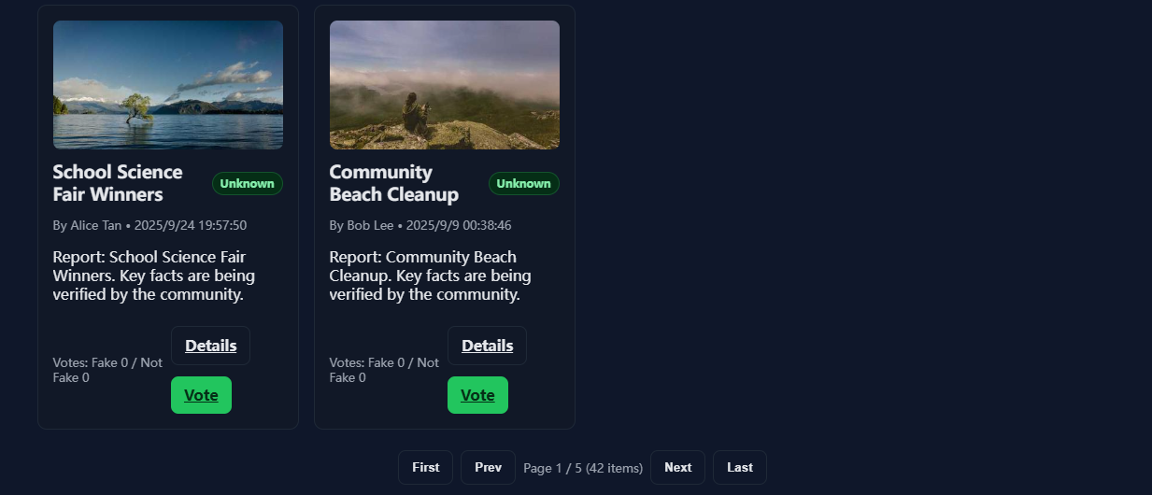
Use Prev/Next or page numbers to navigate; current/total pages are shown.

Slide 8
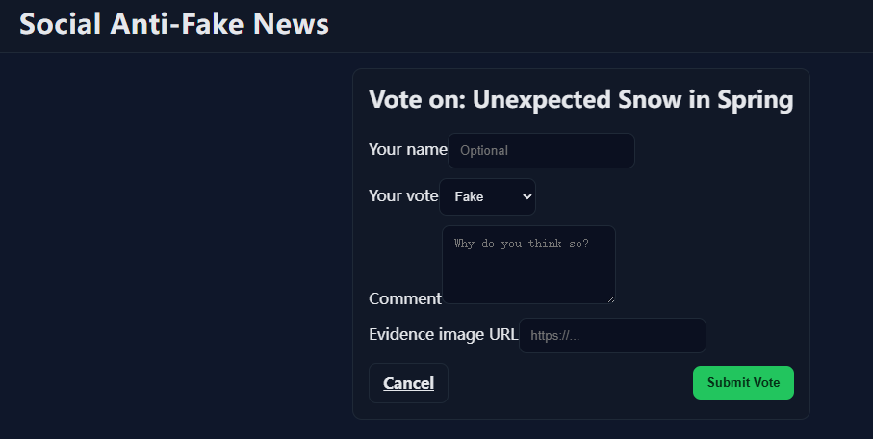
6. News Details Page
- Click a news card to view full details.
- See domain, reporter, date/time, and image/URL.
- Access comments and voting results (fake / not fake).
-Navigate back to the filtered list seamlessly.

Slide 9
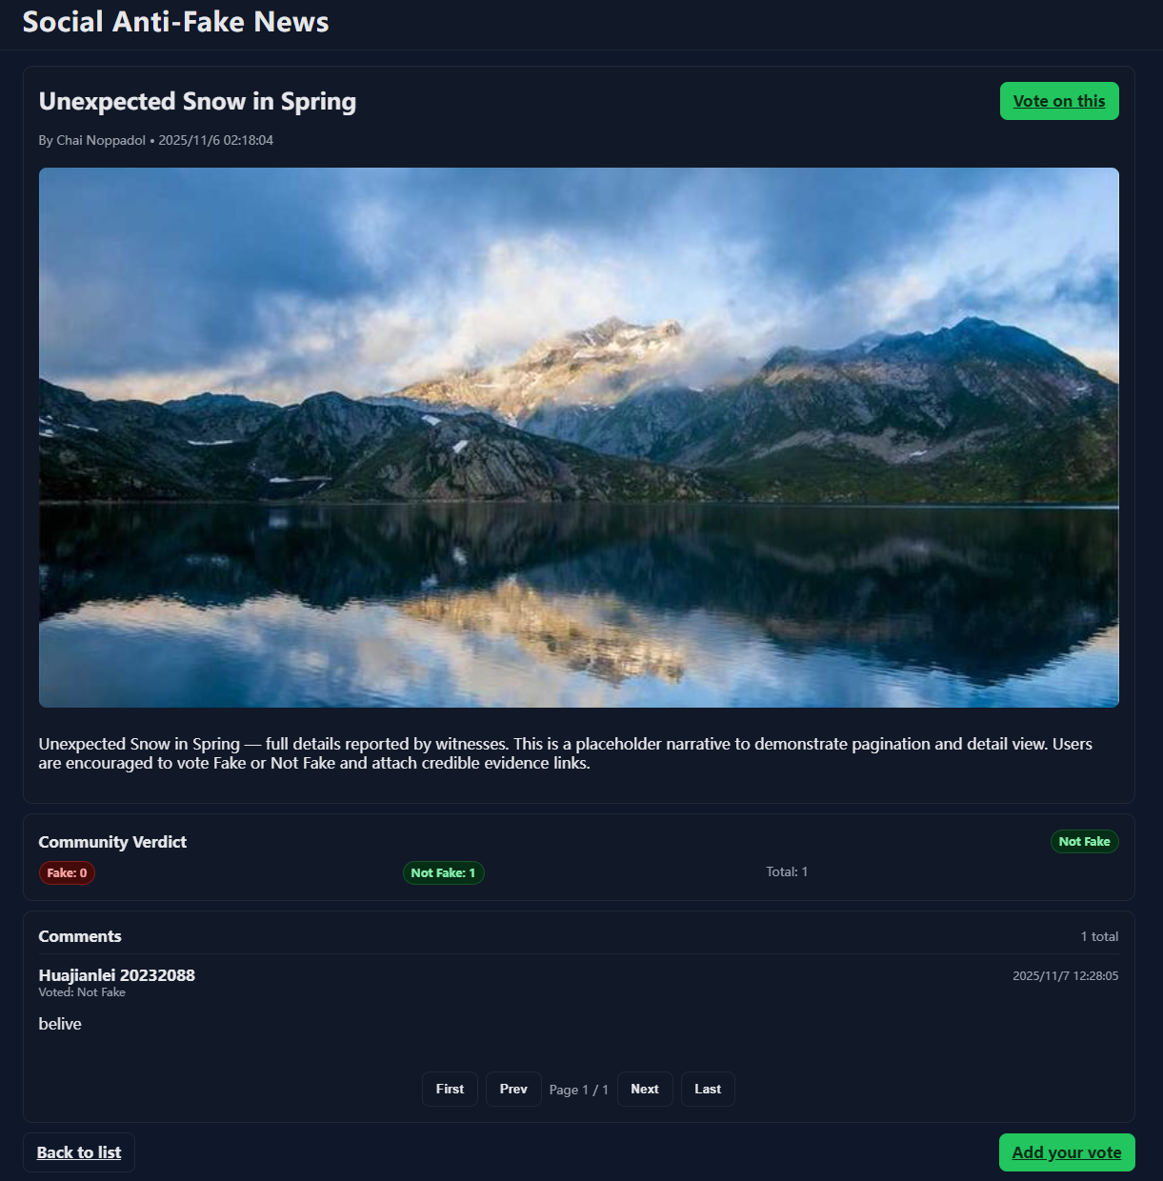
7. Vote & Comment Feature
- Demonstrate voting with a comment or image link.
- New data appears in the comment list immediately.
- Status reflects community voting in real time.

Slide 10
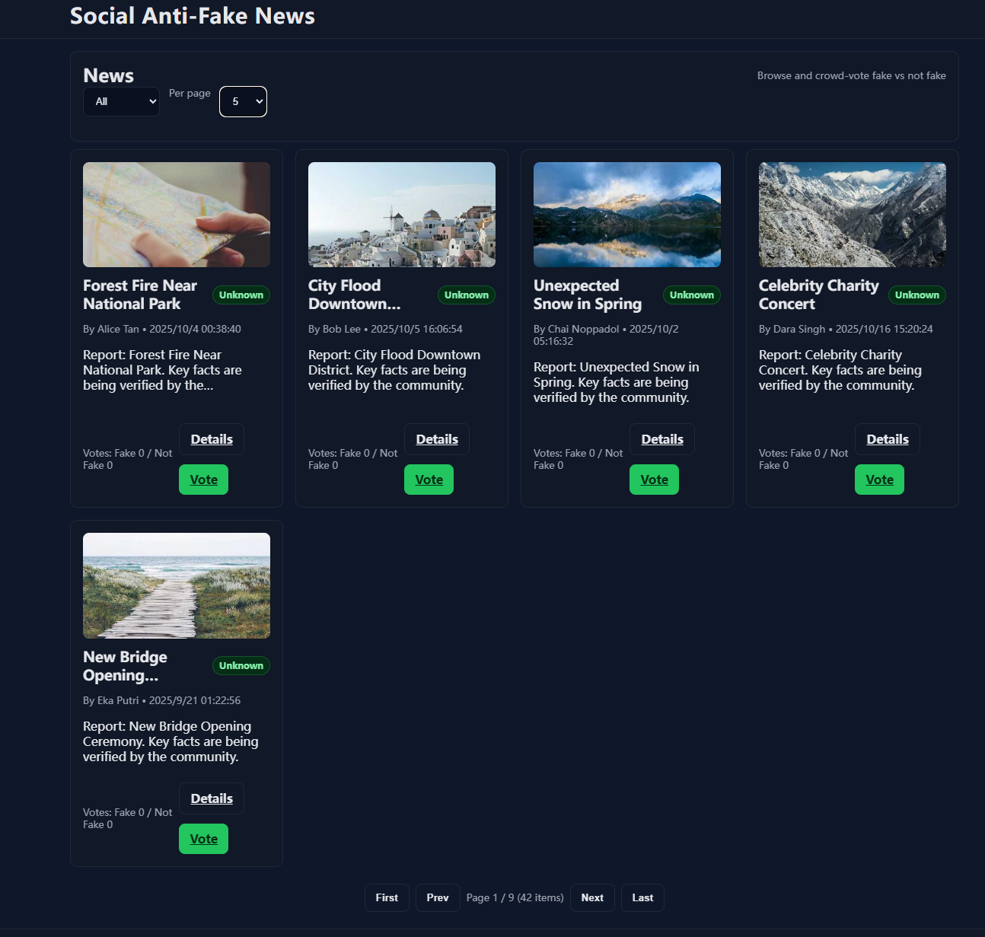
8. Deployment with Versel
- Mention mock data used for testing and pagination implemented

Slide 11
Submission
Record 3-5 mins presentation and submit to Moodle (Only one people in the team will submit in Moodle, you can submit to any section)
Submission Deadline : 9th November 11.59 pm

Slide 12
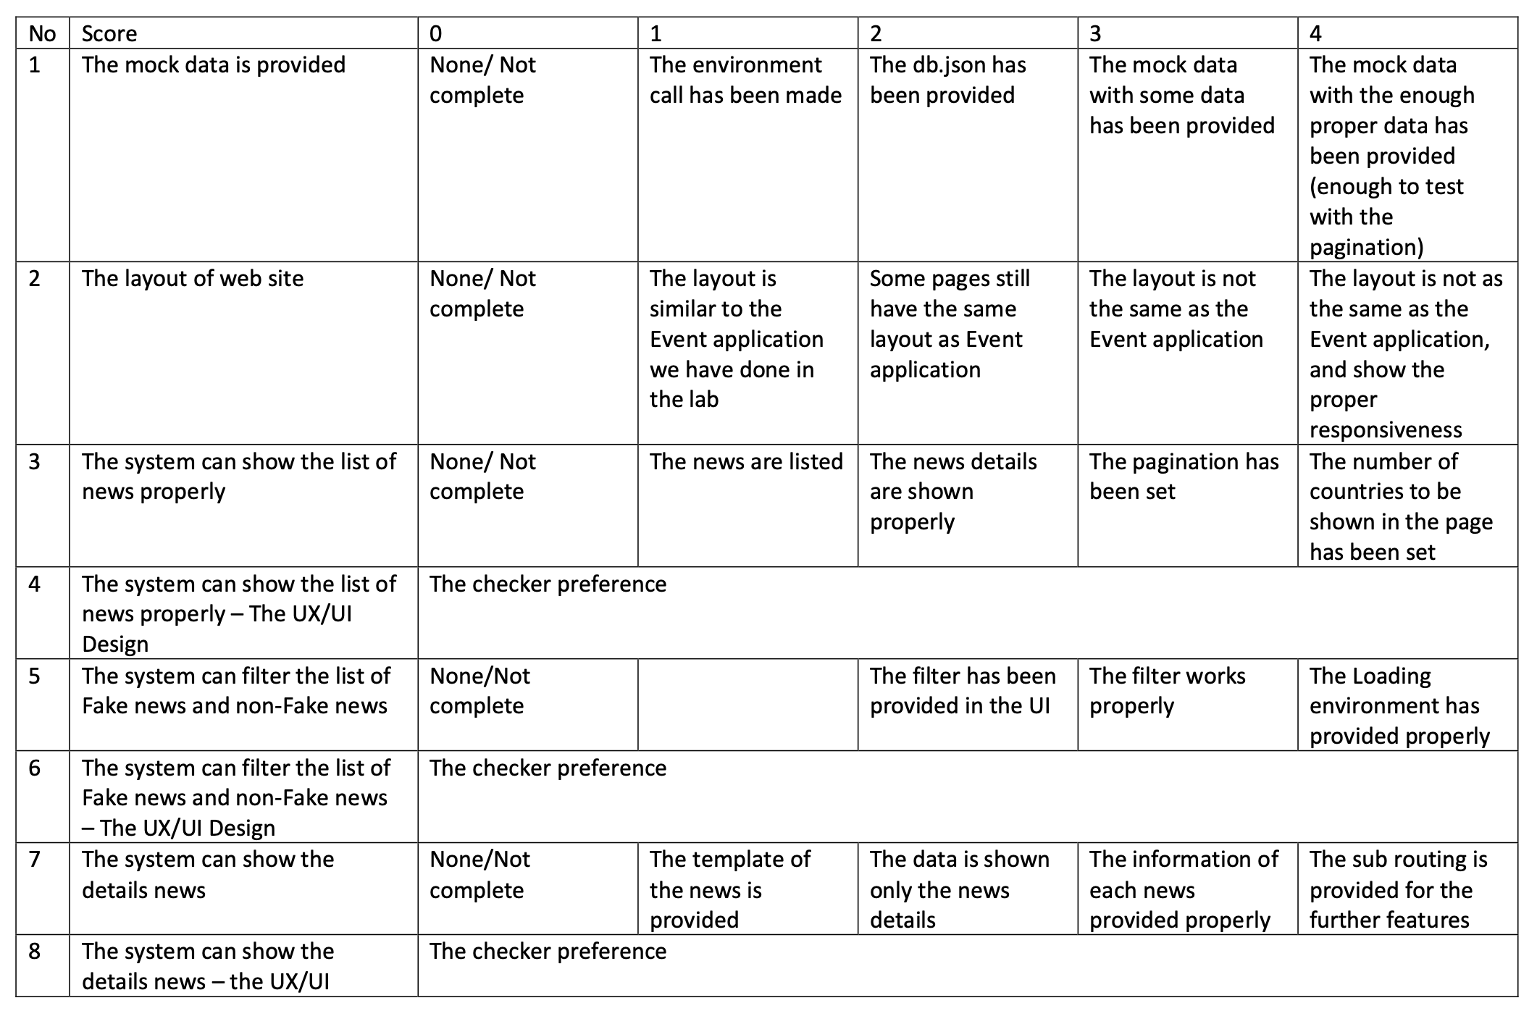

Slide 13
